Slide 1

AAE 875 – Fundamentals of Object Oriented Programming and Data Analytics
Cornelia Ilin, PhD
Department of Ag & Applied Economics
UW-Madison
Week 4 - Summer 2019

Slide 2

Chapter 11: More on Lists and Dictionaries
List nesting
List comprehensions
Dictionary nesting
Functions and Methods

Slide 3
List nesting
# print seed prices, in dollars
# 0: GM-IR 1: GM-HT
prices = [
[
0,
56, # GM-HT
125 # GM-IR
],
[
47 # GM-IR
121 # GM-HT
]
]
user_input = input('Enter seed pair (Ex: 0 1) -- ').strip()
seed1, seed2 = user_input.split()
print('Prices: %d dollars' % prices[int(seed1)][int(seed2)])

Slide 4
List comprehension
# print seed prices, in dollars
# 0: GM-IR 1: GM-HT
prices = [
[
0,
56, # GM-HT
125 # GM-IR
],
[
47 # GM-IR
121 # GM-HT
]
]
sum_list = [sum(row) for row in my_list]
print(sum_list)

Slide 5
Dictionary nesting
# print seed prices, in dollars
prices = {}
prices = {
'2018': {
'GM-IR': [79, 80],
'GM-HT': [120, 87]
},
'2019': {
'GM-IR': [110, 122],
'GM-HT': [65, 89]
}
}
print(prices['2018']['GM-HT'])

Slide 6
Functions and Methods
Covered in the first week (Ch 3)

Slide 7
Chapter 12: IO Files
Version control
Reading (Input)
Writing (Output)
The 'with' statement
Interacting with the file systems

Slide 8
Version control
Extremely important for project file management!

Slide 9
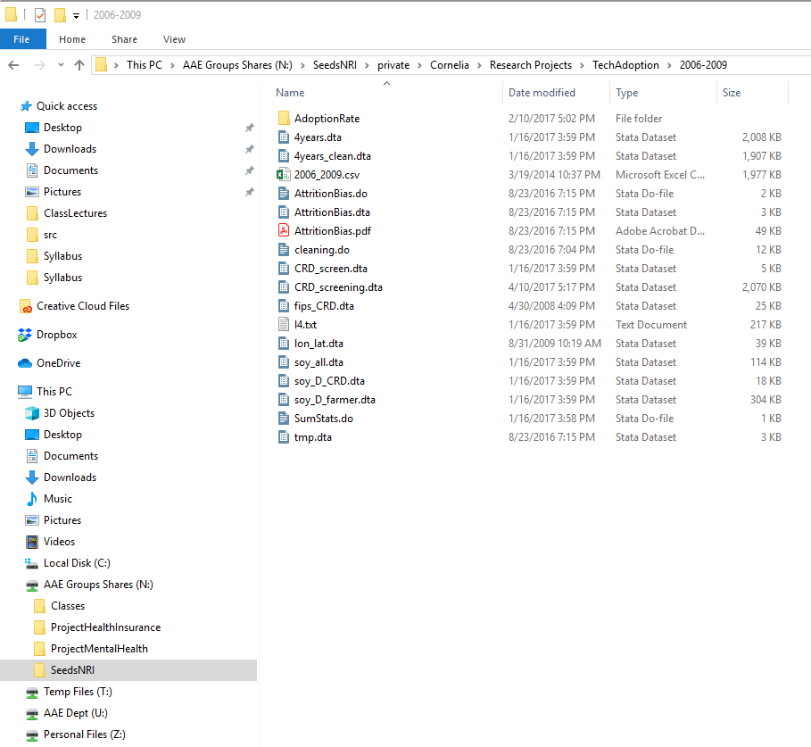
Version control
Extremely important for project file management!
This is me a couple of years ago!
Sadly, I am not able to tell you what is the main code, what each data set means… why I have .csv, .txt, .pdf files in the same place with no related meaning… I don't know!!!

Slide 10
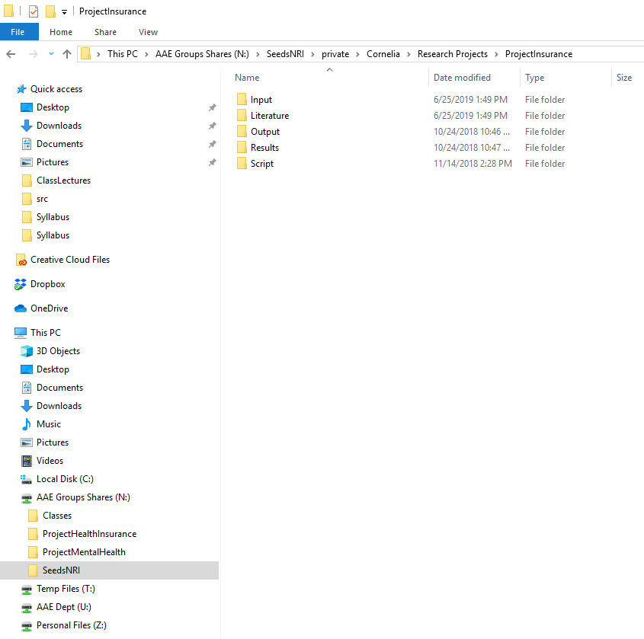
Version control
Extremely important for project file management!
And this is me after grad school
Just ask me a question about this project to see if I know what's going on here ☺

Slide 11
Version control
Extremely important for project file management!
Allows for collaborations (what if a team of 10 people work on the same project at the same time?)

Slide 12
Version control
Extremely important for project file management!
Allows for collaborations (what if a team of 10 people work on the same project?)
Two types of version control:
Local, in a computer's hard drive (cat-proof but not disaster-proof)
In the cloud, stored on a server (cat-proof and disaster-proof)

Slide 13
Version control - local
What if you work for a company whose work is deemed 'highly confidential'?
You cannot put any work on a server that is located at some address in Western Europe

Slide 14
Version control - local
What if you work for a company whose work is deemed 'highly confidential'?
You cannot put any work on a server that is located at some address in Western Europe
All you can do is to implement version control in a computer's hard drive
Allows for collaborations – provided computers are connected to the same network

Slide 15
Version control - local
Literature
Paper1
Input
RawData
Output
Stats
Results
Report1
Script
Paper2
FinalData
Regressions
Report2
Stats
Regressions
One example of Project Management (suitable for economists)

Slide 16
Version control - local
Literature
Paper1
Input
RawData
Output
Stats
Results
Report1
Script
Paper2
FinalData
Regressions
Report2
Stats
Regressions
One example of Project Management (suitable for economists)
How can we track changes made? (yes, you will change your code multiple times!)

Slide 17
Version control - local
Literature
Paper1
Input
RawData
Output
Stats
Results
Report1
Paper2
FinalData
Regressions
Report2
One example of Project Management (suitable for economists)
Script
Stats
06.25.2019
06.26.2019
06.30.2019
Regressions
Option 1: Never edit existing code! Create a new version and edit there
How can we track changes made? (yes, you will change your code multiple times!)

Slide 18
Version control - local
Literature
Paper1
Input
RawData
Output
Stats
Results
Report1
Script
Paper2
FinalData
Regressions
Report2
Stats
Regressions
One example of Project Management (suitable for economists)
Option 2: use Git, a distributed version-control system
<Topic covered in Lab this week>
How can we track changes made? (yes, you will change your code multiple times!)

Slide 19
Version control - server
Code written on your computer's hard drive is cat-proof but not disaster-proof
Disaster-proof: if your computer explodes there is no way for you to recover the information
To disaster-proof your work “push” your local project folder to a server (confidentiality?)
GitHub offers you this service (i.e. GitHub can host a (Git) repository)

Slide 20
Version control - server
Code written on your computer's hard drive is cat-proof but not disaster-proof
Disaster-proof: if your computer explodes there is no way for you to recover the information
To disaster-proof your work “push” your local project folder to a server (confidentiality?)
GitHub offers you this service (i.e. GitHub can host a (Git) repository)
Keep in mind that Git ≠ GitHub <covered in Lab this week>

Slide 21
Top Hat Question # 1
Set up a project folder in your own computer. What is the best way to do this if information is confidential?

Slide 22
Data Analytics
We are just a few steps away from the world of data analytics with Python

Slide 23
Data Analytics
We are just a few steps away from the world of data analytics with Python
What did you learn so far?
Fundamental programming concepts (well, if you can get a data analyst job w/o good command of these concepts let us know!)

Slide 24
Data Analytics
We are just a few steps away from the world of data analytics with Python
What did you learn so far?
Fundamental programming concepts (well, if you can get a data analyst job w/o good command of these concepts let us know!)
Data types in Python (compare this with R)

Slide 25
Data Analytics
We are just a few steps away from the world of data analytics with Python
What did you learn so far?
Fundamental programming concepts (well, if you can get a data analyst job w/o good command of these concepts let us know!)
Data types in Python (compare this with R)
Code/Folder organization

Slide 26
Data Analytics
We are just a few steps away from the world of data analytics with Python
What else do we need to know?
How to input/output files in Python (aka IO files)
Data structures in Python

Slide 27
Data types
set data type
Primitive
Non-primitive
Integer
Float
Boolean
String
List
Tuple
Array
Dictionary
Set
File
numeric data types
sequence data types
mapping data type
file data type
I/O

Slide 28
Input data
As economists we often need to read data from a file
We then need to process that data to produce some useful statistics, regression results, etc.
Data can come in different forms
For example data can be in string form, numeric form and/or comma separated
How to we read it in Python?

Slide 29
Input data
Before going into details, 3 commands are useful:
# open the file
stringfile = open('workfile' [, 'w'])
# read the file
data = stringfile.read([size])
# close the file
stringfile.close()
More information here:
https://docs.python.org/3.3/tutorial/inputoutput.html

Slide 30
Input data
Before going into details, 3 commands are useful:
# open the file
stringfile = open(workfile' [, 'w'])
# read the file
data = stringfile.read([size])
# close the file
stringfile.close()
The open() function creates a file object
The file object is named stringfile in this example

Slide 31
Input data
Before going into details, 3 commands are useful:
# open the file
stringfile = open(workfile' [, 'w'])
# read the file
data = stringfile.read([size])
# close the file
stringfile.close()
The open() function creates a file object
Most commonly used with two arguments:
The first argument contains the file name

Slide 32
Input data
Before going into details, 3 commands are useful:
# open the file
stringfile = open(workfile' [, 'w'])
# read the file
data = stringfile.read([size])
# close the file
stringfile.close()
The open() function creates a file object
Most commonly used with two arguments:
The first argument contains the file name
The second argument (optional) defines the mode the file will be used:

Slide 33
Input data
Before going into details, 3 commands are useful:
# open the file
stringfile = open(workfile' [, 'w'])
# read the file
data = stringfile.read([size])
# close the file
stringfile.close()
The open() function creates a file object
Most commonly used with two arguments:
The first argument contains the file name
The second argument (optional) defines the mode the file will be used:
r: if only reading (this is the default)
w: if only writing
a: opens the file for appending (data is added to the end)
r+, w+, a+ : opens the data for both reading and writing

Slide 34
Input data
Before going into details, 3 commands are useful:
# open the file
stringfile = open(workfile' [, 'w'])
# read the file
data = stringfile.read([size])
# close the file
stringfile.close()
The read() method saves the content of the file object (stringfile) as a string

Slide 35
Input data
Before going into details, 3 commands are useful:
# open the file
stringfile = open(workfile' [, 'w'])
# read the file
data = stringfile.read([size])
# close the file
stringfile.close()
The read() method saves the content of the file object (stringfile) as a string
Size is an optional argument:

Slide 36
Input data
Before going into details, 3 commands are useful:
# open the file
stringfile = open(workfile' [, 'w'])
# read the file
data = stringfile.read([size])
# close the file
stringfile.close()
The read() method saves the content of the file object (stringfile) as a string
Size is an optional argument:
If omitted or negative, the entire data of the file will be read
If positive, reads up to ?? bytes

Slide 37
Input data
Before going into details, 3 commands are useful:
# open the file
stringfile = open(workfile' [, 'w'])
# read the file
data = stringfile.read([size])
# close the file
stringfile.close()
Closes the file object (recommended, to save memory)

Slide 38
Input data – string form
Print the data in the file 'text.txt'
# open the file
stringfile = open('text.txt')
# read the file
data = stringfile.read()
# close the file
stringfile.close()
# print the data
print(data)

Slide 39
Input data – string form
Read all the lines of the 'text.txt' file in a list. Print only the first line of the file
# open the file
stringfile = open('text.txt')
# read the file
data = stringfile.readlines()
# close the file
stringfile.close()
# print the data
print(data[0])
The readlines() method returns a list of strings
See also the readline() method

Slide 40
Top Hat Question # 2
What is the output?
# open the file
stringfile = open('text.txt')
# read the file
data = stringfile.readlines()
# close the file
stringfile.close()
# print the data
print(data[1])

Slide 41
Input data – string form
Read all the lines of the 'text.txt' file in a list. Print the data
# open the file
stringfile = open('text.txt')
# read the file
data = stringfile.readlines()
# close the file
stringfile.close()
# print the data
for rows in data:
print(rows)

Slide 42
Top Hat Question # 3
What is the output?
# open the file
stringfile = open('text.txt')
# read the file
data = stringfile.readlines()
# close the file
stringfile.close()
# print the data
for rows in stringfile:
print(rows)

Slide 43
Input data – numeric form
Read all the lines of the 'numeric.txt' file in a list. Print the average number
# open the file
numfile= open('numeric.txt')
# read the file
data = numfile.readlines()
# close the file
numfile.close()
# compute and print the average
total = 0
for row in data:
total += int(row)
average = total/len(data)
print('The average is', average)

Slide 44
Input data – comma separated form
Most often data is organized in a spreadsheet format or database (columns x rows)
A .CSV file separates data items by comma (cells)
How do we read such data in Python?

Slide 45
Input data – comma separated form
Most often data is organized in a spreadsheet format or database (columns x rows)
A .CSV file separates data items by comma (cells)
How do we read such data in Python?
The Python csv module implements classes to read tabular data in CSV format
import csv
# open the file
csvfile = open('workfile' [,'w', newline = ''])
# read the file
data = csv.reader(filename [,delimiter = ','])
# close the file
csvfile.close()
More information here:
https://docs.python.org/3/library/csv.html

Slide 46
Input data – comma separated form
Most often data is organized in a spreadsheet format or database (columns x rows)
A .CSV file separates data items by comma
How do we read such data in Python?
The Python csv module implements classes to read tabular data in CSV format
import csv
# open the file
csvfile = open('workfile' [,'w', newline = ''])
# read the file
data = csv.reader(filename [,delimiter = ','])
# close the file
csvfile.close()
The reader() function in the csv module returns a reader object which will iterate over lines in a given .csv file;

Slide 47
Input data – comma separated form
Most often data is organized in a spreadsheet format or database (columns x rows)
A .CSV file separates data items by comma
How do we read such data in Python?
The Python csv module implements classes to read tabular data in CSV format
import csv
# open the file
csvfile = open('workfile' [,'w', newline = ''])
# read the file
data = csv.reader(filename [,delimiter = ','])
# close the file
csvfile.close()
The reader() function in the csv module returns a reader object which will iterate over lines in a given .csv file;
Each row read from the csv file is returned as a list of strings;

Slide 48
Input data – comma separated form
Most often data is organized in a spreadsheet format or database (columns x rows)
A .CSV file separates data items by comma
How do we read such data in Python?
The Python csv module implements classes to read tabular data in CSV format
import csv
# open the file
csvfile = open('workfile' [,'w', newline = ''])
# read the file
data = csv.reader(filename [,delimiter = ','])
# close the file
csvfile.close()
The reader() function in the csv module returns a reader object which will iterate over lines in a given .csv file;
Each row read from the csv file is returned as a list of strings;
A couple of notes on arguments:
filename is a file object created via open (e.g. csvfile)
delimiter (optional) specifies the argument used in the csv file to separate fields. The default is comma (new cell).

Slide 49
Input data – comma separated form
Read each row of the 'seeds.csv' file
import csv
# open the file
csvfile= open('seeds.csv', 'r+', newline = '')
# read the file
data = csv.reader(csvfile, delimiter = ',')
# print each row
row_no = 1
for row in data:
print('Row #', row_no, ':', row)
row_no += 1
# close the file
csvfile.close()

Slide 50
Top Hat Question # 4
What is the output?
import csv
# open the file
csvfile = open('seeds.csv', 'r+', newline = '')
# read the file
data = csv.reader(csvfile, delimiter = ',')
# print each row
row_no = 1
for row in data:
print('Row #', row_no, ':', row)
# close the file
csvfile.close()

Slide 51
Input data – comma separated form
Read each row of the 'seeds.csv' file. Compute the average of GM prices paid by farmers
import csv
# open the file
csvfile = open('seeds.csv', 'r+', newline = '')
# read the file
data = csv.reader(csvfile, delimiter = ',')
# print average GM price
total_GMprice = 0
row_num = 0
csvfile.readline() # skips the first row in the csv file
# cont'd
for row in data:
if row[1] == 'Conv':
continue
else:
total_GMprice += int(row[2])
row_num += 1
mean_GMprice = total_GMprice / row_num
print(mean_GMprice)
# close the file
csvfile.close()

Slide 52
Top Hat Question # 5
What is the output?
import csv
# open the file
Csvfile = open('seeds.csv', 'r+', newline = '')
# read the file
data = csv.reader(csvfile, delimiter = ',')
# print average GM price
total_GMprice = 0
row_num = 1
csvfile.readline()
csvfile.readline()
# cont'd
for row in data:
print(row[2])
print(row_num)
# close the file
csvfile.close()

Slide 53
Top Hat Question # 6
What is the output?
import csv
# open the file
csvfile = open('seeds.csv', 'r+', newline = '')
# read the file
data = csv.reader(csvfile, delimiter = ',')
# close the file
csvfile.close()
# print average GM price
total_GMprice = 0
row_num = 1
csvfile.readline()
csvfile.readline()
# cont'd
for row in data:
row_num += 1
print(row[2])
print(row_num)

Slide 54
Top Hat Question # 7
Compute the average quantity sold of GM seeds? Write code. Use the 'seeds.csv' file

Slide 55
Output data – string and/or numeric form
Before going into details, 3 commands are useful:
# open the file
stringfile = open('workfile' [,'w'])
# write the file
stringfile.write([size])
# close the file
stringfile.close()

Slide 56
Output data – string and/or numeric form
Before going into details, 3 commands are useful:
# open the file
stringfile = open('workfile' [,'w'])
# write the file
stringfile.write([size])
# close the file
stringfile.close()
The write() method writes a string to a file

Slide 57
Output data – string and/or numeric form
Before going into details, 3 commands are useful:
# open the file
stringfile = open('workfile' [,'w'])
# write the file
stringfile.write([size])
# close the file
stringfile.close()
The write() method writes a string to a file
Integers and floating-points must be converted using the str() function

Slide 58
Output data – string and/or numeric form
Output 'Hello World' to a file named “my_output.txt”
# open the file
stringfile = open('my_output.txt', 'w')
# write the file
stringfile.write('Hello world \n')
# close the file
stringfile.close()

Slide 59
Top Hat Question # 8
What is the output?
# open the file
stringfile = open('my_output.txt', 'w', newline = '')
# write the file
stringfile.write('Hello world \n')
stringfile.write('I know Python \n')
# close the file
stringfile.close()

Slide 60
Top Hat Question # 9
What is the output?
# open the file
stringfile = open('my_output.txt', 'w')
# write the file
stringfile.write('Hello world')
stringfile.write('I know Python')
# close the file
stringfile.close()

Slide 61
Output data – comma separated form
How do we output data in comma separated format in Python?
The Python csv module implements classes to output tabular data in CSV format
import csv
# open the file
csvfile = open('workfile' [, 'w', newline = ''])
# write the file
data = csv.writer(filename [, delimiter = ' '])
data.writerow('string1'))
data.writerows(['string1', 'string2'])
# close the file
csvfile.close()
More information here:
https://docs.python.org/3/library/csv.html

Slide 62
Output data – comma separated form
How do we output data in comma separated format in Python?
The Python csv module implements classes to output tabular data in CSV format
import csv
# open the file
csvfile = open('workfile' [, 'w', newline = ''])
# write the file
data = csv.writer(filename [, delimiter = ' '])
data.writerow('string1'))
data.writerows(['string1', 'string2'])
# close the file
csvfile.close()
The writer() function in the csv module returns a writer object responsible for converting the user's data into delimited strings on the given workfile

Slide 63
Output data – comma separated form
How do we output data in comma separated format in Python?
The Python csv module implements classes to output tabular data in CSV format
import csv
# open the file
csvfile = open('workfile' [, 'w', newline = ''])
# write the file
data = csv.writer(filename [, delimiter = ' '])
string1 = “Hello”
string2 = “world”
data.writerow(string1))
data.writerows([string1, string2])
# close the file
csvfile.close()
The writer functions writerow() and writerows() can be used to write a list of strings into the file as one or more rows

Slide 64
Top Hat Question # 10
Add a new row ['2', 'Conv', '55', '10', '2018'] to the file seeds.csv

Slide 65
The 'with' statement: Example 1
What if we forget to close a file? There is a solution to make sure Python automatically closes the file: the 'with' statement. It is also a more efficient way to write code
w/o “with”
w/ 'with' version
# open the file
stringfile = open('text.txt')
# read the file
data = stringfile.read()
# close the file
stringfile.close()
# print the data
print(data)
# open the file
with open('text.txt') as stringfile:
# read the file
data = stringfile.read()
# print the data
print(data)

Slide 66
The 'with' statement: Example 2
What if we forget to close a file? There is a solution to make sure Python automatically closes the file: the 'with' statement. It is also a more efficient way to write code
w/o “with” + write()
w/ 'with' version + write()
# open the file
stringfile = open('text.txt', 'a+')
# write to the file:
stringfile.write('Let's see if this works')
# read the file
data = stringfile.read()
# close the file
stringfile.close()
# open the file
with open('text.txt', 'a+') as stringfile:
# write to the file
stringfile.write('Let's see if this works')
# read the file
data = stringfile.read()

Slide 67
The 'with' statement: Example 3
What if we forget to close a file? There is a solution to make sure Python automatically closes the file: the 'with' statement. It is also a more efficient way to write code
w/o “with” + csv.writer()
w/ 'with' version + csv.writer()
import csv
# open the file
csvfile = open('seeds.csv', 'a+', newline = '')
# write to the file
data = csv.writer(csvfile)
data.writerow (['2', 'Conv', '55', '10', '2018'])
# close the file
csvfile.close()
import csv
# open the file
with open('seeds.csv', 'a+', newline = '') as csvfile:
# write to the file
data = csv.writer(csvfile)
data.writerow(['2', 'Conv', '55', '10', '2018'])

Slide 68
Interacting with the file system
Python comes with the OS module that allows your programs to interact with the files in your computer

Slide 69
Interacting with the file system
Python comes with the OS module that allows your programs to interact with the files in your computer
File systems: The computer drive is organized in a hierarchical structure of files and directories
Files: contain information (e.g. txt, csv files)
Directories: these contain files and directories inside of them

Slide 70
Interacting with the file system
Python comes with the OS module that allows your programs to interact with the files in your computer
File systems: The computer drive is organized in a hierarchical structure of files and directories
Files: contain information (e.g. txt, csv files)
Directories: these contain files and directories inside of them
Absolute and relative file paths:
Absolute file paths are notated by a leading forward slash or drive label. Describes how to access a given file or directory starting from the root of the file system
In Windows: Z:\AAE875\EclipseWorkspace\ReadFiles\src

Slide 71
Interacting with the file system
Python comes with the OS module that allows your programs to interact with the files in your computer
File systems: The computer drive is organized in a hierarchical structure of files and directories
Files: contain information (e.g. txt, csv files)
Directories: these contain files and directories inside of them
Absolute and relative file paths:
Absolute file paths are notated by a leading forward slash or drive label. Describes how to access a given file or directory starting from the root of the file system
Relative file paths are notated by a lack of leading forward slash. A relative file path is interpreted from the perspective of your current working directory (cwd)
In Windows: Z:\AAE875\EclipseWorkspace\ReadFiles\src
In Windows: src

Slide 72
Interacting with the file system
Python comes with the OS module that allows your programs to interact with the files in your computer
Why is this important?
Find/change the current working directory
Create/remove files
Code portability across machines (Windows vs Mac paths)
To get the size of a file
etc

Slide 73
Interacting with the file system
What is the current working directory in Python?
How can you change the current working directory to Z:\AAE875\EclipseWorkspace\ReadFiles
import os
print(os.getcwd())
Z:\AAE875\EclipseWorkspace\ReadFiles\src
import os
path = “Z:\AAE875\EclipseWorkspace\ReadFiles”
os.chdir(path)
print(os.getcwd())

Slide 74
Top Hat Question # 11
What is the CWD after the following code is run
import os
path = “Z:\AAE875\”
os.chdir(path)
print(os.getcwd())

Slide 75
Interacting with the file system
How can you create another directory? CWD is 'Z:\AAE875\EclipseWorkspace\ReadFiles\src'
How can you delete tempDir located in the src folder?
import os
# creates tempDir in current (src) directory
os.mkdir('tempDir')
# creates tempDir in another (ReadFiles) directory
os.mkdir('Z:\AAE875\EclipseWorkspace\ReadFiles\tempDir')
relative path
absolute path
import os
# delete tempDir in current (src) directory
os.rmdir('tempDir')

Slide 76
Top Hat Question # 11
What happens in the computer file system when the following code is run?
import os
import datetime
curr_day = datetime.datetime.today()
year = str(curr_day.year)
month = str(curr_day.month)
day = str(curr_day.day)
dot = '.'
os.chdir("Z:\AAE875\Eclipse Workspace")
print(os.getcwd())
dir = year + dot + month + dot + day
os.mkdir(dir)

Slide 77
Interacting with the file system
How can you delete files (broadly speaking) in Python
os.remove(path) will remove a file
os.rmdir(path) will remove an empty directory
os.rmtree(path) will remove a directory and all its contents
Note: once you run code with these commands the files are gone (unless you have initialized it with Git!

Slide 78
Interacting with the file system
How can we make sure the same path is compatible on both Windows and Mac?
import os
print(os.getcwd())
In Windows:
Z:\AAE875\EclipseWorkspace\ReadFiles\src

Slide 79
Interacting with the file system
How can we make sure the same path is compatible on both Windows and Mac?
import os
print(os.getcwd())
In Windows:
Z:\AAE875\EclipseWorkspace\ReadFiles\src
import os
print(os.getcwd())
In Mac:
home/AAE875/EclipseWorkspace/ReadFiles/src

Slide 80
Interacting with the file system
How can we make sure the same path is compatible on both Windows and Mac?
The os.path module contains functions for handling file paths
In Windows:
Z:\AAE875\EclipseWorkspace\ReadFiles\src
In Mac:
/home/AAE875/EclipseWorkspace/ReadFiles/src
import os
path = os.path.join('Z:\\', 'AAE875', 'EclipseWorkspace', 'ReadFiles', 'src')
This command will create a Windows like path if run on a Windows machine

Slide 81
Why economists use Python?
To manipulate, process, clean, and analyze data in Python
What kind of data? Structured data that can contain different data types (you should already be familiar with this term!)

Slide 82
Data structures
A particular way of organizing and storing data efficiently
Built-in Python data structures:
Set
List
Tuple
Dictionary
Third-party Python data structures:
Vectors
Matrices
Arrays
Data Frames

Slide 83

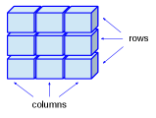
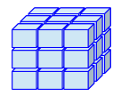
Third-party data structures
Vectors are one–dimensional arrays (1 column or row of data, 1 data type only)
Matrices are two-dimensional arrays (multiple columns and/or rows of data, 1 data type only)
Arrays are similar to matrices but can be multi-dimensional (1 data type only)

Slide 84
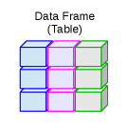
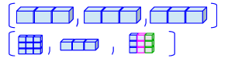
Third-party data structures
Data Frames are a generalization of matrices but they can store more than 1 type of data
Finally, compare all these third-party data structures with lists (built-in in Python):

Slide 85
Essential Python packages for Data Analysis
Data visualization
matplotlib (as plt)
seaborn (as sns)
Data transformation
numpy (as np)
Descriptive statistics
scipy (as sp), built on top of numpy
pandas (as pd)
Regression analysis
Statsmodels (as sm)

Slide 86
Essential Python packages for Data Analysis
Machine learning
Scikit-learn (as sks)

Slide 87
Data visualization - Matplotlib
A plotting library for Python and its numerical mathematics extension NumPy
Supports 2D plots only
You can generate plots, histograms, power spectra, bar charts, errorcharts, scatterplots, etc., with just a few lines of code.
Link: https://matplotlib.org/

Slide 88
Data visualization - Seaborn
A plotting library for Python based on matplotlib
Provides a high-level interface for drawing attractive and interactive graphics
Link: https://seaborn.pydata.org/

Slide 89
Data transformation - NumPy
A fast and efficient multidimensional array object
Functions for performing element-wise/mathematical computations with/between arrays
Tools for reading and writing array-based datasets to disks
Linear algebra operations, random number generation
Link: https://numpy.org/

Slide 90
Descriptive stats - SciPy
Built on top of numPy (array data structure)
A collection of packages for scientific computing
scipy.optimize: function optimizers (minimizers)
scipy.sparse: sparse matrices and sparse linear system solvers
scipy.stats: standard continuous and discrete probability distributions, statistical tests, descriptive stats
Link: https://www.scipy.org/

Slide 91
Descriptive stats - Pandas
Blends the high-performance, array-computing idea of NumPy with the flexible data manipulation capabilities of spreadsheets and relational databases such as SQL
Makes it easy to reshape, slice and dice, perform aggregations, select subsets of data, perform descriptive statistics
Link: https://pandas.pydata.org/pandas-docs/version/0.22/index.html#module-pandas

Slide 92
Regression analysis - Statsmodels
Is a statistical analysis package that includes submodules for:
Regression analysis, ANOVA, nonparametric methods (kernel density, kernel regression), etc.
Visualization of regression analysis results
Link: https://www.statsmodels.org/stable/index.html

Slide 93
Regression analysis - scikit-learn
The machine learning toolkit for Python programmers
Includes submodules for: classification, regression, clustering, model selection, processing, etc.
Link: https://scikit-learn.org/stable/

Slide 94
References
Third-party data structures (pictures):
http://venus.ifca.unican.es/Rintro/dataStruct.html
Info on data analytics packages in Python
Wes McKinney (2018): Python for Data Analysis, Second Edition, O’Reilly Media

